Slide 1
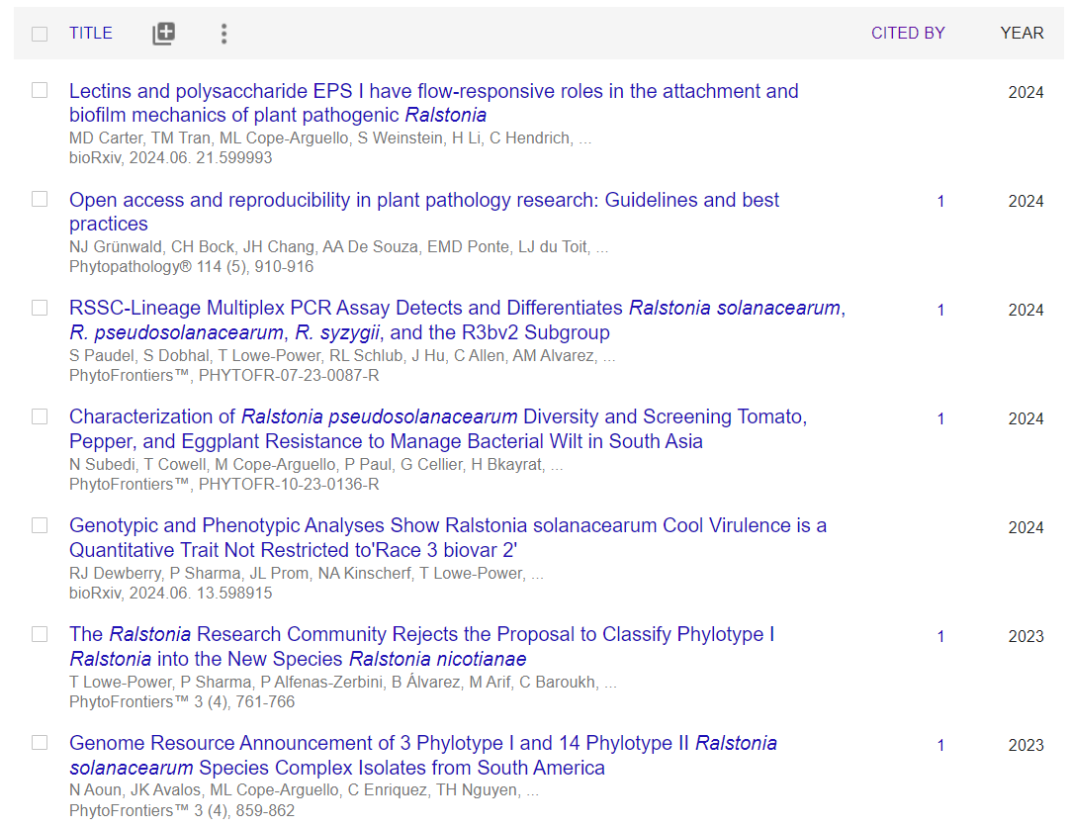
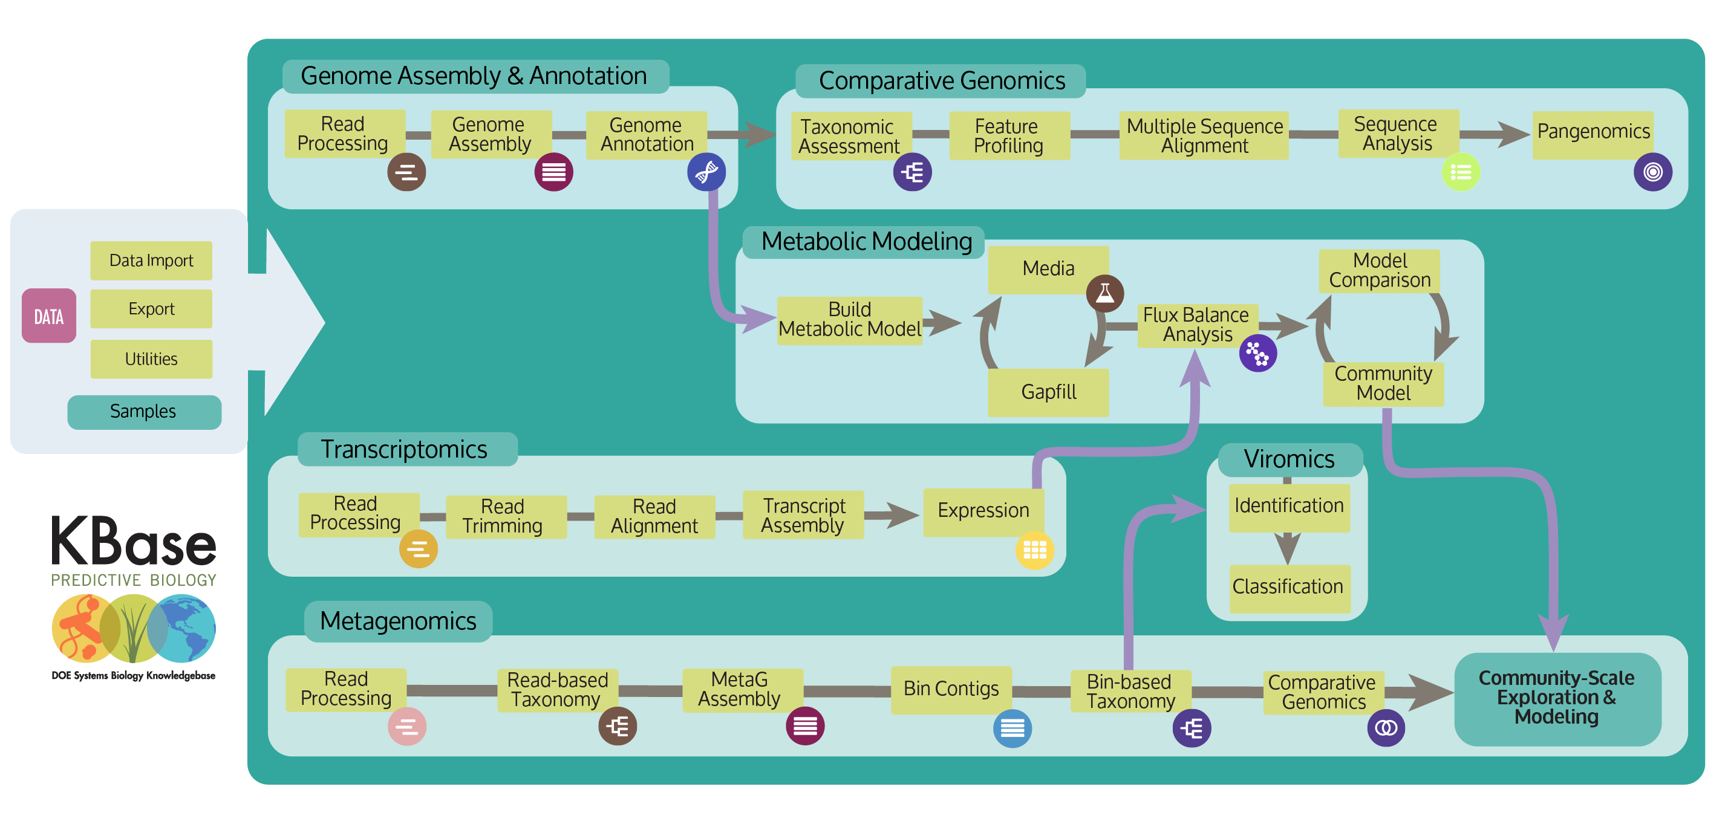
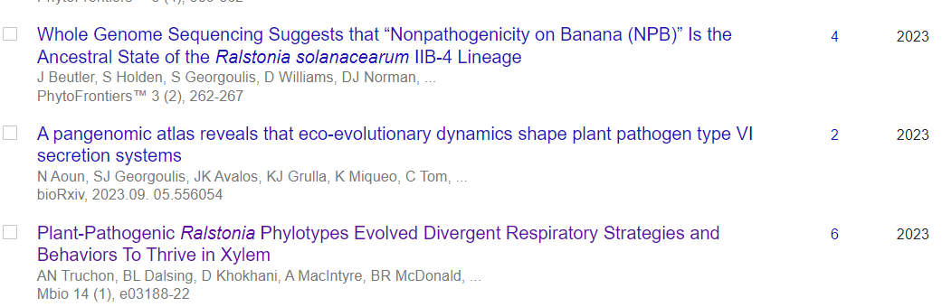
My Goals: Share my opinions on “best practices” for using KBase
and share anecdotes of how KBase has advanced our Ralstonia research
Tiffany Lowe-Power
UC Davis

Slide 2
You can use KBase for a lot of things

Slide 3
My lab mostly uses KBase for
Ralstonia genome assembly and comparative genomics

Slide 4
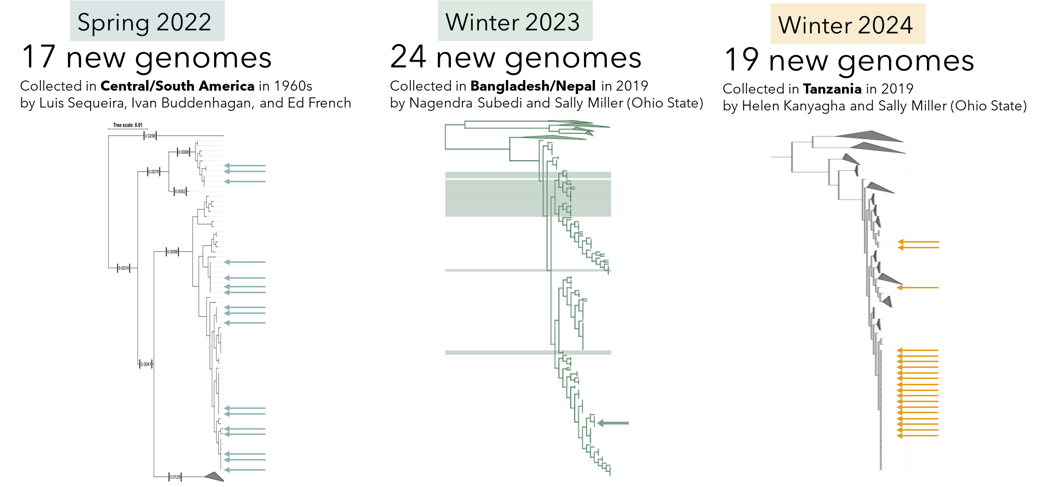

Generating public Ralstonia genomic data using KBase
Aoun et al. 2023
Subedi et al. 2023
Kanyagha and Elmgreen et al. in prep
Release genomes to
NCBI Assembly/SRA

Slide 5


Check out my talk to hear about how we integrate education with our plant health / Ralstonia research

Slide 6
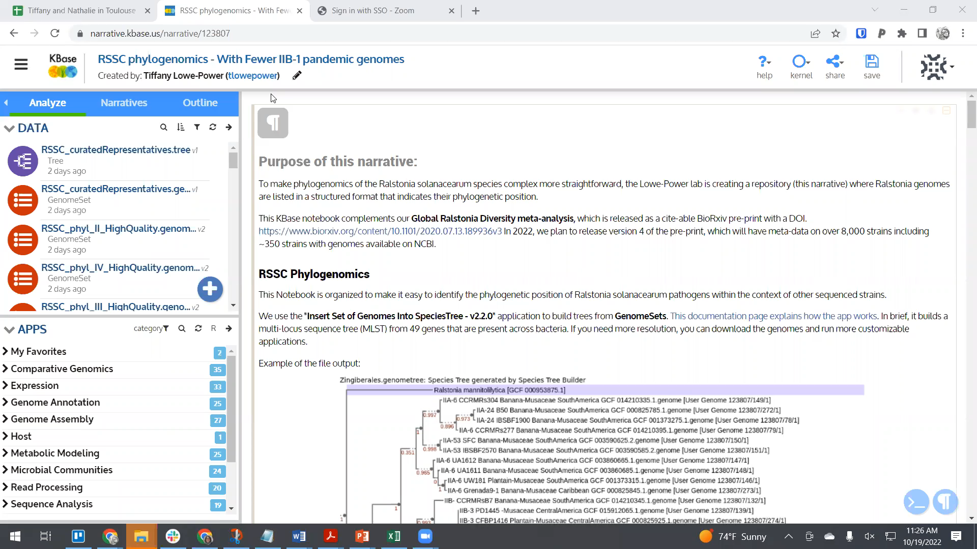
What is KBase?
A good platform point-and-click genomics
No coding required, but “markdown language” to format notebook entries is a gateway to coding

Slide 7
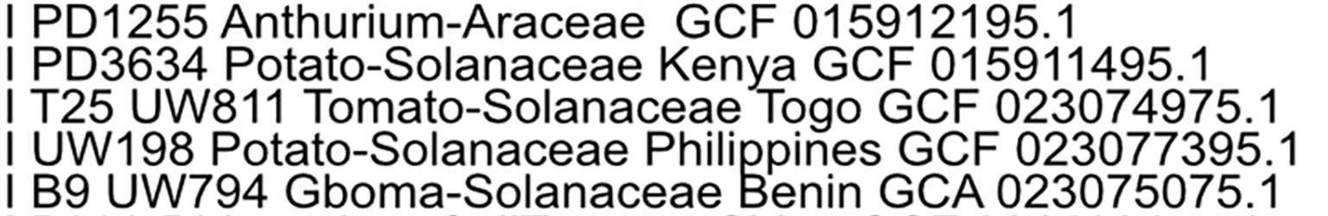
Building a KBase GenomeSet / Narrative for phylogenomics of your favorite bacterial species
Step 1: Decide on how you want to name the genomes.
I like to add the meta-data in human-readable format.
phylotype
Strain name
Host Plant
Location
Genome Accession
(NCBI RefSeq preferred)

Slide 8
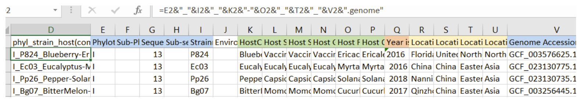
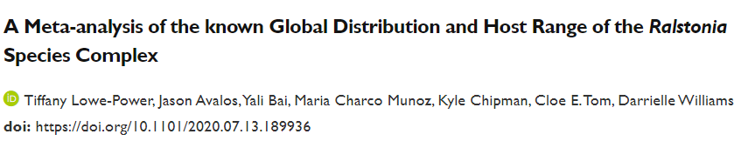
Building a KBase GenomeSet / Narrative for phylogenomics of your favorite bacterial species
Step 1: Decide on how you want to name the genomes.
I like to add the meta-data in human-readable format.
I use excel to organize metadata (phylotype, strain name, host, location, genome accession).
Then I concatenate a filename using excel “coding”: &
Note: KBase files cannot have spaces. Underscores_ and hyphens- allowed.
This datasheet is adapted from our Ralstonia diversity database (available on BioRxiv as an excel sheet. Interactive dashboard coming soon)

Slide 9
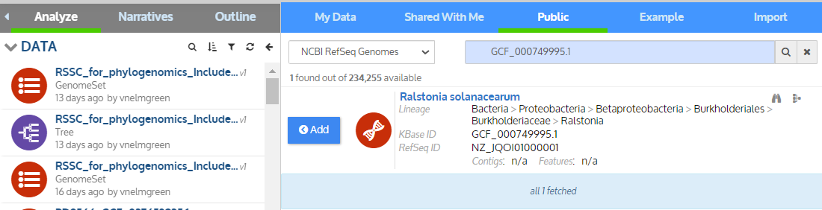

Building a KBase GenomeSet / Narrative for phylogenomics of your favorite bacterial species
Step 2: Create a Narrative called “Phylogenomics for Ralstonia”.
Bring the genomes into the KBase Narrative.
Option 1: KBase has pre-loaded many genomes from NCBI (recent genomes may not be present)
Search with NCBI RefSeq accessions (GCF_xxxxxx)
Warning: Do not trust the lineage information, which comes from NCBI. NCBI taxonomy is currently a mess (but they are trying to improve).
You should use the genome taxonomy database (gtdb.ecogenomic.org) for the most accurate information.

Slide 10

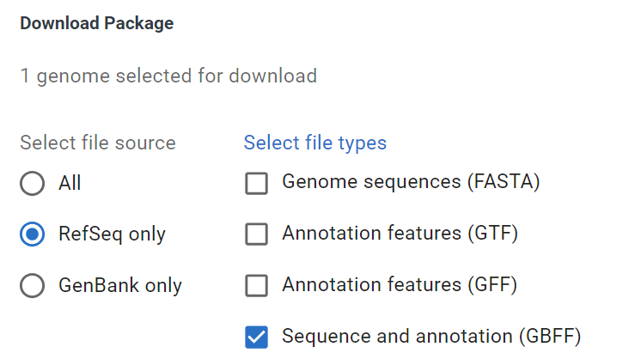
Building a KBase GenomeSet / Narrative for phylogenomics of your favorite bacterial species
Step 2: Create a Narrative called “Phylogenomics for Ralstonia”.
Bring the genomes into the KBase Narrative.
Option 2: Download data from NCBI / other servers
Suggestion: Use NCBI RefSeq format and download the .gbff (DNA+annotations = “KBase Genome”) and not the .fasta (DNA only = “KBase Assembly”)
One genome at a time approach:

Slide 11
Building a KBase GenomeSet / Narrative for phylogenomics of your favorite bacterial species
Step 2: Create a Narrative called “Phylogenomics for Ralstonia”.
Bring the genomes into the KBase Narrative.
Option 2: Download data from NCBI / other servers
Suggestion: Use NCBI RefSeq format and download the .gbff (DNA+annotations = “KBase Genome”) and not the .fasta (DNA only = “KBase Assembly”)
Batch of genomes approach:
Good luck. It looks like NCBI just updated how to do this.

Slide 12
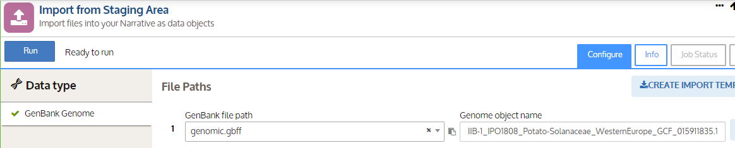
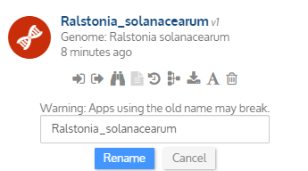



Building a KBase GenomeSet / Narrative for phylogenomics of your favorite bacterial species
Step 3: Name the genomes with an informative name.
(My approach is tedious, sorry)
If data was pre-loaded in KBase, manually rename (copy/paste carefully from your excel file with the names)
If you need to import data, you can name the object when using the Import from Staging Area app
Useful for large batches
Repeat ad naseum

Slide 13
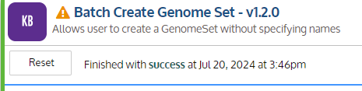
Building a KBase GenomeSet / Narrative for phylogenomics of your favorite bacterial species
Step 4: Create a genomeSet with Batch Create Genome Set
Example name:
RSSC_for_phylogenomics_IncludesBadQualityGenomes_v2023-11-11.genomeSet
Next we will use CheckM to identify which genomes are bad quality
It is a good idea to use version control with dates if you plan to update the narrative as new genomes are sequenced

Slide 14
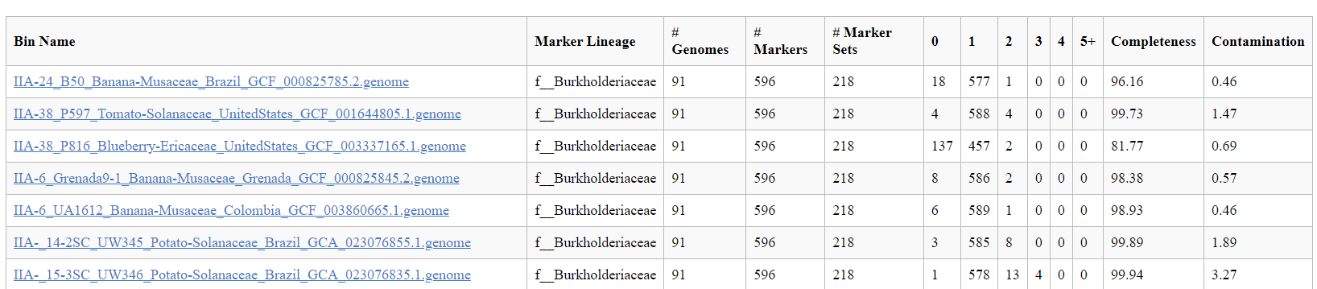
Building a KBase GenomeSet / Narrative for phylogenomics of your favorite bacterial species
Step 5: Quality control the data
My approach: CheckM to check completeness and contamination in the assembly.
https://kbase.us/dynserv/66e9a37e7d3a56b64cc372c89d1eaafaa605c397.HTMLFileSetServ/api/v1/123807/1565/1/$/0/CheckM_Table.html <-- link to a checkM result for the high quality RSSC genomes
https://kbase.us/dynserv/66e9a37e7d3a56b64cc372c89d1eaafaa605c397.HTMLFileSetServ/api/v1/123807/1571/1/$/0/CheckM_Table.html <-- link to a checkM result for the bad quality RSSC genomes

Slide 15
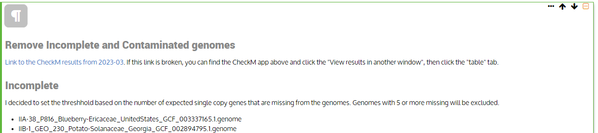
Building a KBase GenomeSet / Narrative for phylogenomics of your favorite bacterial species
Step 5: Quality control the data
My approach: CheckM to check completeness and contamination in the assembly.
I keep track of the bad genomes in a markdown window
I still find the bad quality genomes useful for high-level phylogenomics, but I don’t want to use them for comparative genomics

Slide 16
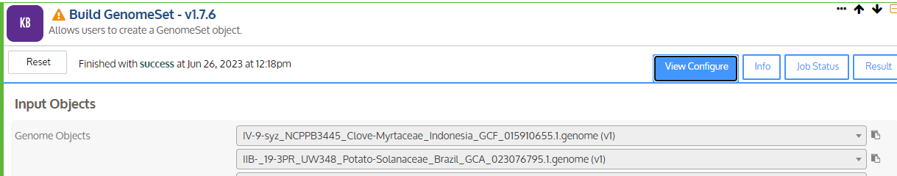
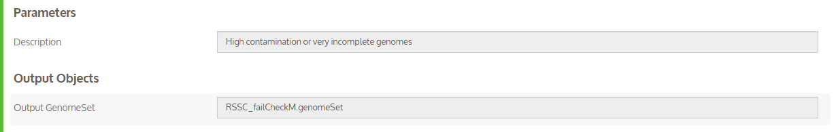

Building a KBase GenomeSet / Narrative for phylogenomics of your favorite bacterial species
Step 5: Quality control the data
My approach: CheckM to check completeness and contamination in the assembly.
Use the KBase “Build GenomeSet” app to select all of the bad genomes
Suggested genomeSet name

Slide 17
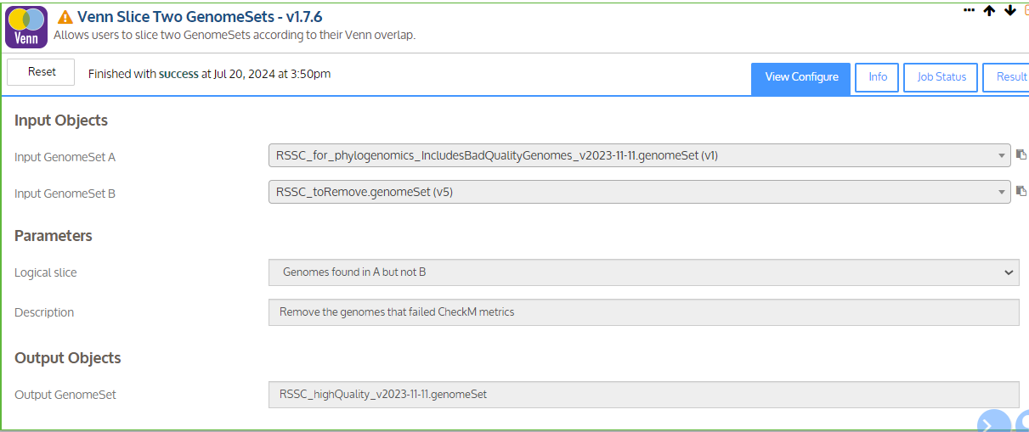
Building a KBase GenomeSet / Narrative for phylogenomics of your favorite bacterial species
Step 5: Quality control the data
My approach: CheckM to check completeness and contamination in the assembly.
Use the KBase “Venn Slice” app to make a genome set with only the high-quality genomes
Suggested genomeSet name

Slide 18
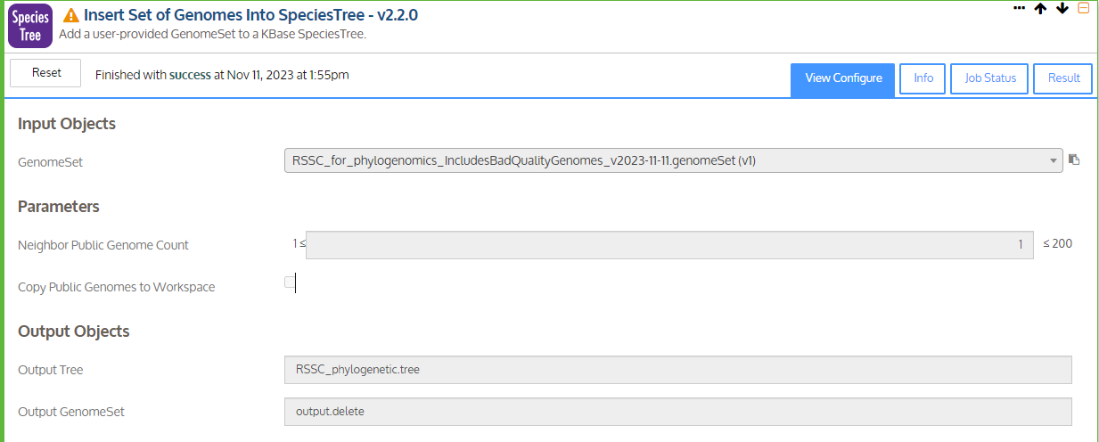

Building a KBase GenomeSet / Narrative for phylogenomics of your favorite bacterial species
Step 6: Build a Species Tree!
This app makes an approximate maximum likelihood tree based on 49 conserved bacterial genes. Read the info for more details
KBase quirk. I would prefer to have 0 “neighbor genomes”, but 1 is the minimum. This leads to a duplication for a genome in my species tree (it’s always GMI1000 for Ralstonia)
I like to name these files .tree
There are some KBase outputs that I do not find useful. I name these .delete, .temp, .trash …

Slide 19
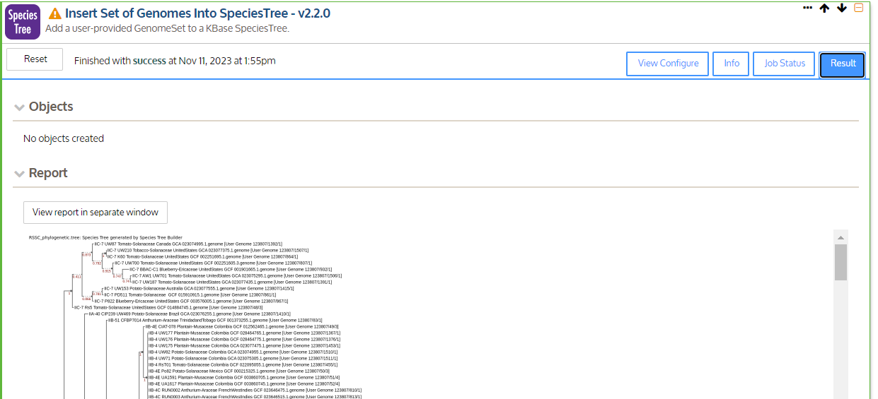
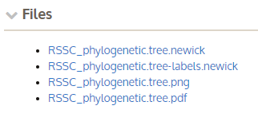
Building a KBase GenomeSet / Narrative for phylogenomics of your favorite bacterial species
Step 6: Build a Species Tree!
I use the SpeciesTree to assign phylotypes to genomes that do not have phylotype information. I also manually check that phylotypes were assigned correctly
(scroll past this static image. Not very user friendly)
The files are useful.
I open the .pdf first. You can do Ctrl+F searches in the PDF. The .newick can be opened in your favorite tree viewing software. My lab uses iToL ($100/year cost, but I find it worth it)

Slide 20
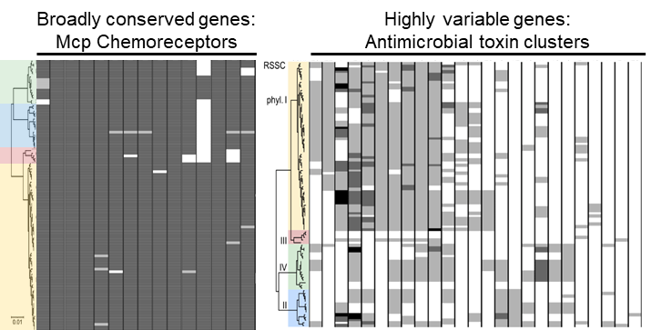
Using KBase for comparative genomics of your favorite bacterial species
KBase BLASTP is awesome
Figures that our lab likes to make with KBase (and iToL) Phylogenetic distribution of genes
KBase Species Tree
Results from BLASTP searches on KBase
iToL used to combine blast results with the .newick trees and for aesthetics

Slide 21
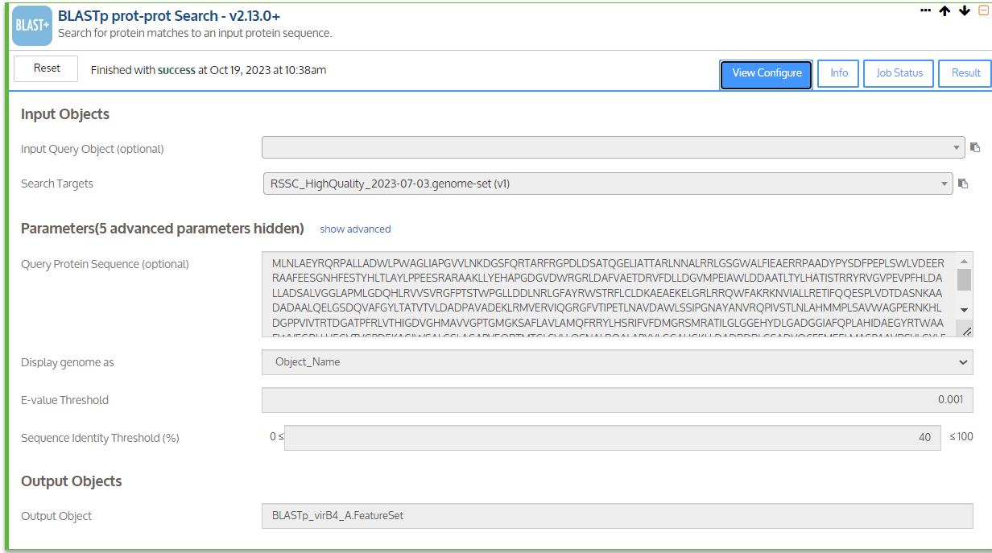
Using KBase for comparative genomics of your favorite bacterial species
ProTip: Don’t use your phylogenomics narrative for exploration.
Import the genomeSets into fresh narratives
KBase BLASTP is awesome
(minor gripe: tBLASTn is not in KBase and KBase-BLASTn cannot search intergenic regions)

Slide 22
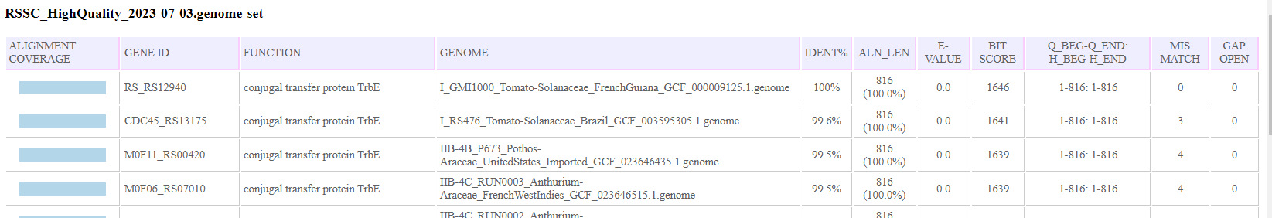
Using KBase for comparative genomics of your favorite bacterial species
KBase BLASTP is awesome
(minor gripe: tBLASTn is not in KBase and KBase-BLASTn cannot search intergenic regions)
Output table can be copy/pasted to excel to organize data (and later upload to iToL if you have an iToL subscription) https://itoleditor.letunic.com/
If you uploaded the RefSeq version of the genomes, you can search these gene tags and pull up the genomic region on NCBI
Example output. (Please do not scoop undergrad Tabitha Cowell who is conducting a comparative genomics study on conjugative T4SS in Ralstonia) https://kbase.us/dynserv/66e9a37e7d3a56b64cc372c89d1eaafaa605c397.HTMLFileSetServ/api/v1/147707/436/1/$/0/RSSC_HighQuality_2023-07-03.genome-set-BLASTp_Search.html

Slide 23
Using KBase for comparative genomics of your favorite bacterial species
KBase BLASTP is awesome
(minor gripe: tBLASTn is not in KBase and KBase-BLASTn cannot search intergenic regions)
Output table can be copy/pasted to excel to organize data (and later upload to iToL if you have an iToL subscription) https://itoleditor.letunic.com/
If you uploaded the RefSeq version of the genomes, you can search these gene tags and pull up the genomic region on NCBI
Example output. (Please do not scoop undergrad Tabitha Cowell who is conducting a comparative genomics study on conjugative T4SS in Ralstonia) https://kbase.us/dynserv/66e9a37e7d3a56b64cc372c89d1eaafaa605c397.HTMLFileSetServ/api/v1/147707/436/1/$/0/RSSC_HighQuality_2023-07-03.genome-set-BLASTp_Search.html

Slide 24
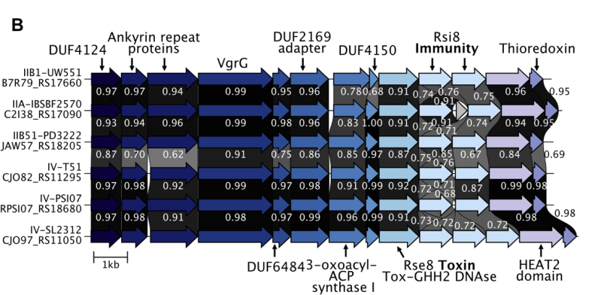
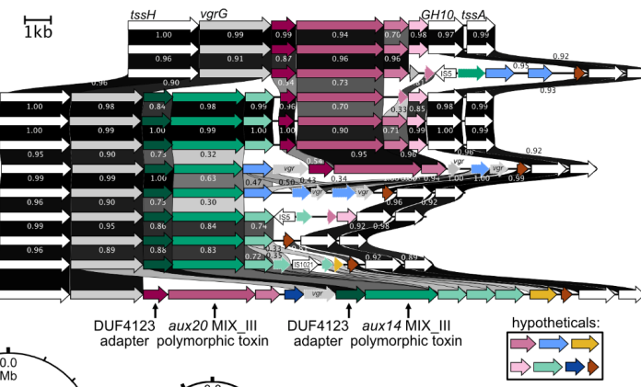
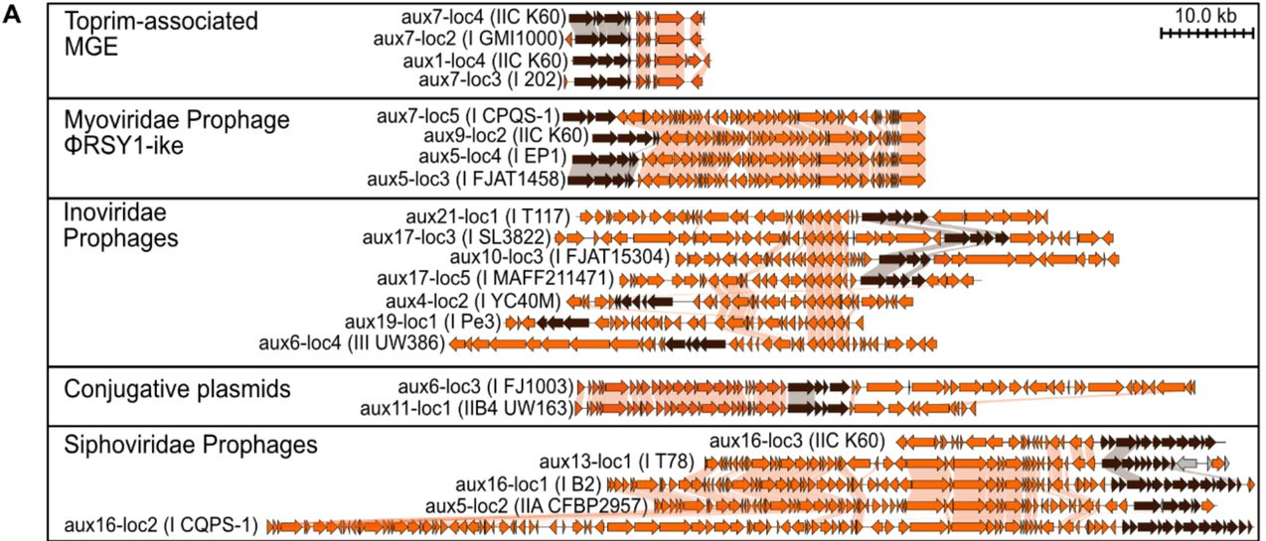
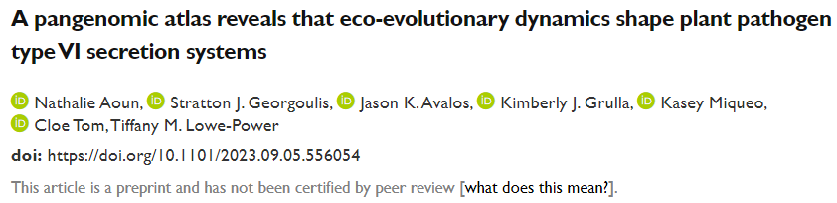
Using KBase for comparative genomics of your favorite bacterial species
KBase BLASTP is awesome
Figures that our lab likes to make with KBase (and Clinker) Interactive synteny figures
We have interactive Clinker synteny plots from our T6SS atlas paper on the lab website https://lowepowerlab.ucdavis.edu/datasets

Slide 25
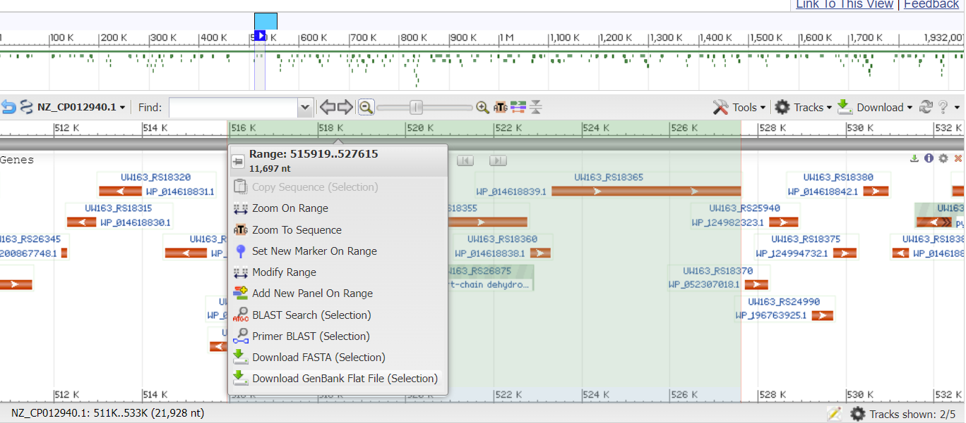
Using KBase for comparative genomics of your favorite bacterial species
KBase BLASTP is awesome
Figures that our lab likes to make with KBase (and iToL)
KBase BLAST
Search gene on NCBI nucleotide.
From graphics page, download genbank flat file (.flat)
Convert .flat to .gbk (just type the different file extension) and run command line program Clinker https://github.com/gamcil/clinker
(once installed, this is very easy)
We have interactive Clinker synteny plots from our T6SS atlas paper on the lab website https://lowepowerlab.ucdavis.edu/datasets

Slide 26
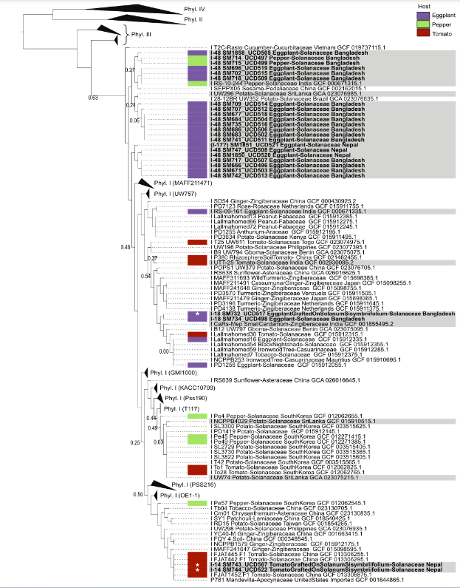

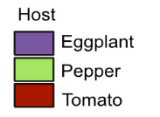
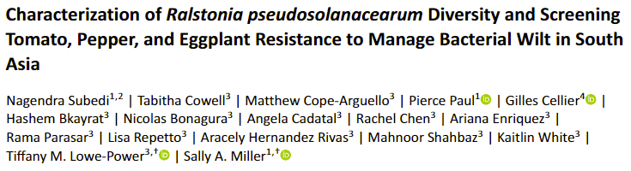
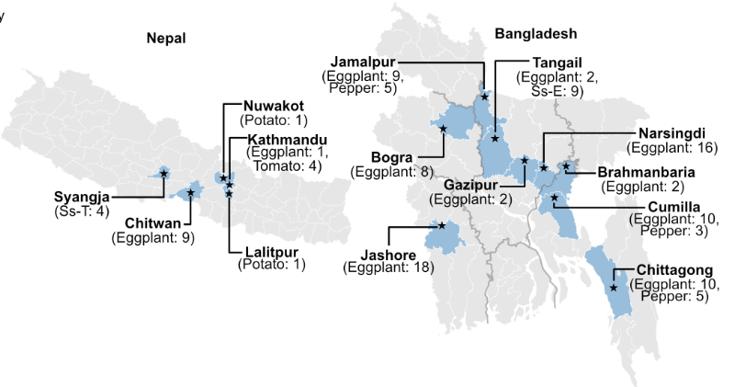
Using KBase for phylogenomic insight

Slide 27
Using KBase for phylogenomic insight
Bold = genomes from Nagedra’s survey
Grey = genomes from South Asia

Slide 28
Using KBase for phylogenomic insight
Bold = genomes from Nagedra’s survey
Grey = genomes from South Asia
South Asian cluster
Hypothesis:
Strains that were introduced from Eastern Asia

Slide 29
Using KBase for phylogenomic insight
Bold = genomes from Nagedra’s survey
Grey = genomes from South Asia
Isolates from Tomato/ Eggplant grafted to weedy Solanaceae used as resistant roots in Bangladesh. … is breakdown of resistance in Bangladesh due to introduction of new strains?

